Slide 1

Web Analytics
Dan Pham - Kostiantyn Reva - Navdeep Singh - Precious Osarenren - Suhong Liang
Big Data Analytics – BDAT1009
Professor Keith Connell
April 2019

Slide 2
CONTENT
1
2
3
4
5
Introduction
The city of Baton Rouge
Analytics purpose
Overview performance
Website analytics
Comparison with the city of Bloomington
Key takeaways

Slide 3

INTRODUCTION
City of Baton Rouge
Capital city of Louisiana
Located on the eastern bank of the Mississippi River, it is the most populous parish in Louisiana
A major industrial, petrochemical, medical, research, motion picture, and growing technology center of the American South
Population: 229,493
Area: 79.11 sq mi

Slide 4

INTRODUCTION
Analytics Purposes
Review the overall performance of the website throughout the period
Identify key changes and assumptions
Recommendations

Slide 5
OVERVIEW PERFORMANCE
9
Functional Site Split
Brogov.com
Budget.brla.gov
Data.brla.gov
Gis.brla.gov
My.brla.gov
311.Brla.gov
Data.ebrgis.opendata.arcgis.com
City.brla.gov
www.brla.gov
8
8
Brgov.com
Budget.brla.gov
Data.brla.gov
Gis.brla.gov
My.brla.gov
311.Brla.gov
Data.ebrgis.opendata.arcgis.com
Brgov.com
Budget.brla.gov
Data.brla.gov
Gis.brla.gov
My.brla.gov
311.Brla.gov
Data.ebrgis.opendata.arcgis.com
5
Brgov.com
Budget.brla.gov
Data.brla.gov
Gis.brla.gov
My.brla.gov
1
Brgov.com
2014
2015
2016
2017
2018
Notes:
The history of Baton Rough function sites split: 2014 only 1 websites, while in 2015, 4 extra websites showed up. Move on to 2016 another 3 websites increased and keep the same numbers of websites in the following year. In 2018, Brogov.com change its domain to www.brla.gov and another website city.brla.gov is created.

Slide 6


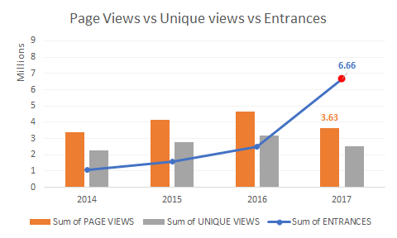
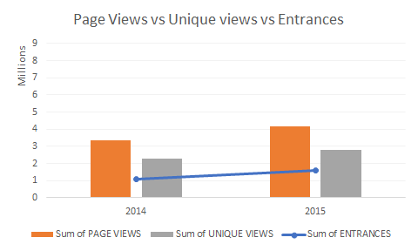
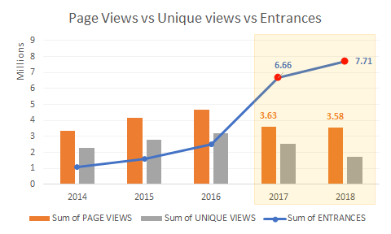
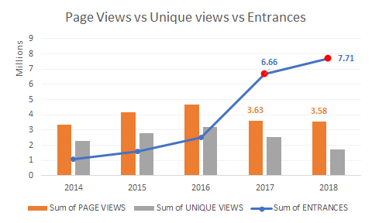
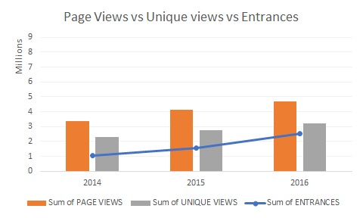
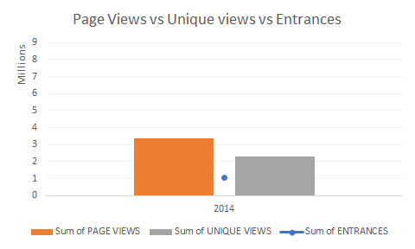
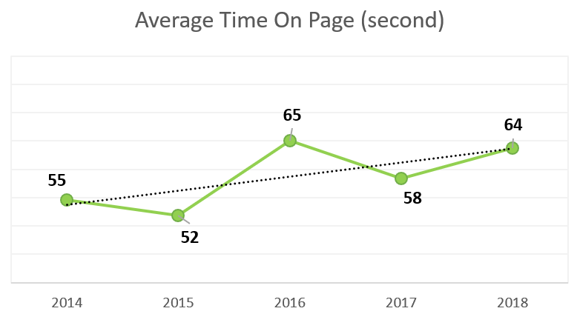
OVERVIEW PERFORMANCE
Drop in pageview, unique view since 2016
Tagging problem in 2017 (on-going issue)
Increase in Pageview/unique view
Increase in Average time on page
Notes:
Page view/Unique view and total entrance (aggregate the data, using sum to measure )
From 2014 to 2016, the website traffic saw a gradually. However, both page view and unique view drop down after 2016
Generally speaking, Entrance < unique view < page view. But as you can see from the chart in the left hand side, in 2017 and 2018, the abnormal phenomenon of entrance much larger than the page view and unique view indicates that there are probably has tagging problem.
2. Average time on page (mean)
- The overall trend of the average time on page during the past 5 years are stable.

Slide 7
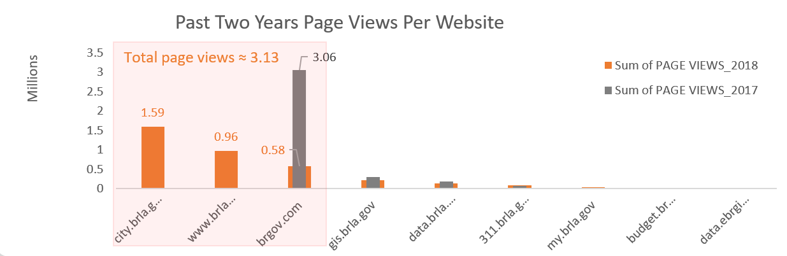
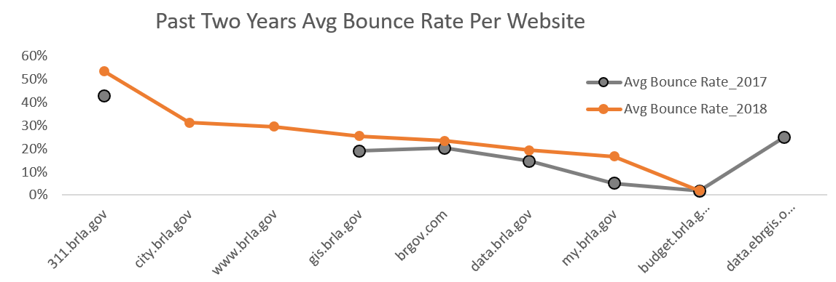
OVERVIEW PERFORMANCE
Transition of Domains
In 2018, City of Baton Rouge changed their domain from BRGov.com to BRLA.gov
Provides new design provides more robust features, user-featured elements and enhanced functionality for doing business
The new website is responsive and optimized for smartphones and tablets
Notes:
As you can see the page views of websites city.brla.gov + www.brla.gov + brgov.com in 2018 approximate brgov.com in 2017

Slide 8
WEBSITE ANALYTICS
Sitemap
Brgov.com
Data.Brla.gov
Brla.gov
Complex structure of sitemap
Lengthy urls
Not friendly urls (meaningful)
1344
94
1191
Sub-page level 1
http://brgov.com/dept/brpd/www.brgov.com/dept/dept/dept/dept/dept/dept/dept/dept/dept/dept/dept/dept/dept/dept/dept/dept/dept/dept/dept/planning/dept/dept/dept/planning/dept/planning/dept/dept/dept/dept/planning/dept/dept/dept/dept/hr/

Slide 9




WEBSITE ANALYTICS
Page Speed Analysis (by developers.Google)
Desktop
Recommendation
Eliminate render-blocking resources
Defer unused CSS
Reduce server response times (TTFB)
Ensure text remains visible during webfont load
Avoid an excessive DOM size
Minimize main-thread work
Reduce JavaScript execution time
Serve static assets with an efficient cache policy
Minimize Critical Requests Depth
Speed Index
Time to Interactive
Mobile
Speed Index
Time to Interactive First CPU Idle Estimated Input Latency First Contentful Paint First Meaningful Paint
Notes:
Speed Index shows how quickly the contents of a page are visibly populated
Time to interactive is the amount of time it takes for the page to become fully interactive.
First Contentful Paint marks the time at which the first text or image is painted.
First Meaningful Paint measures when the primary content of a page is visible
First CPU Idle marks the first time at which the page's main thread is quiet enough to handle input.
Estimated Input Latency is an estimate of how long your app takes to respond to user input, in milliseconds, during the busiest 5s window of page load. If your latency is higher than 50 ms, users may perceive your app as laggy.

Slide 10
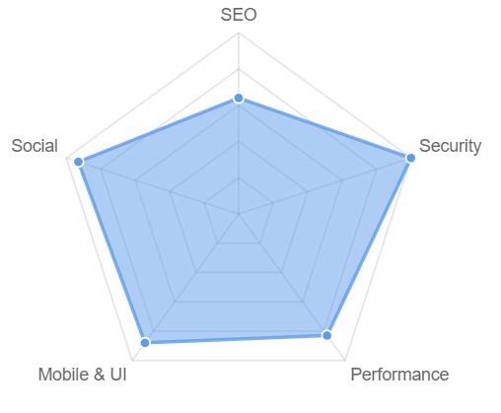

WEBSITE ANALYTICS
SEO Analysis (by SEOptimer)
Title tag
Amount of content
Number of backlinks
No broken links
XML Sitemaps
Analytics (GA)
Robots.txt
Meta description tag
Header tag
Keyword consistency
Image Alt attributes
Friendly URLs
Optimized Images

Slide 11

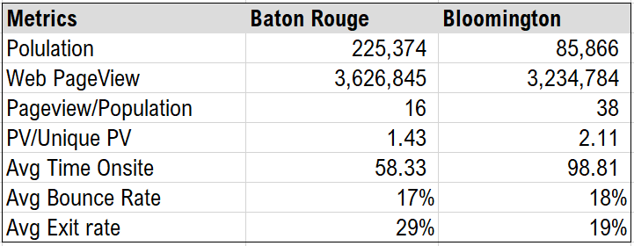
COMPARISON WITH THE CITY OF BLOOMINGTON
Bloomington is the fifth largest city in the U.S. state of Minnesota. It is located in Hennepin County on the north bank of the Minnesota River, above its confluence with the Mississippi River.
Despite having much larger population, Baton Rouge’s government website only attracted a similar number of pageviews
Bloomington has better quality of traffic in terms of PV/Unique PV, Avg Time on Site, Exit Rate
Bloomington has higher page speed score: 70 Mobile, 84 Desktop
Bloomington keeps all pages consistently in a single domain
Web Performance comparison between Baton Rouge & Bloomington

Slide 12
KEY TAKEAWAYS
Critical areas to consider for web optimization
Restructure sitemap to be more user-friendly
Track web tags (Entrance)
SEO optimization:
Tags (Meta, header)
Keywords
Images
URLs
Web optimization:
CSS
JavaScript
Image next-gen formats
Server

Slide 13
REFERENCES
https://www.brla.gov
https://developers.google.com/speed/pagespeed/insights/?url=https%3A%2F%2Fwww.brla.gov%2F
https://www.similarweb.com/website/brla.gov
https://www.seoptimer.com/brla.gov
https://www.visitbatonrouge.com
https://www.city.brla.gov
https://www.brla.gov
https://www.gis.brla.gov
https://www.data.brla.gov
https://www.311.brla.gov
https://www.my.brla.gov
https://www.budget.brla.gov
https://www.data.ebrgis.opendata.arcgis.com
https://en.wikipedia.org/wiki/Baton_Rouge,_Louisiana
https://en.wikipedia.org/wiki/Bloomington,_Minnesota

Slide 14
Thank you
Dan Pham - Kostiantyn Reva - Navdeep Singh - Precious Osarenren - Suhong Liang

